Slide 1
Photomicrographs of Plant foods
Pepper: Green & Pimento
Permission to reproduce original photomicrographs used to make this collection may be obtained from
Dr. David O. Norris at
david.norris@colorado.edu

Slide 2
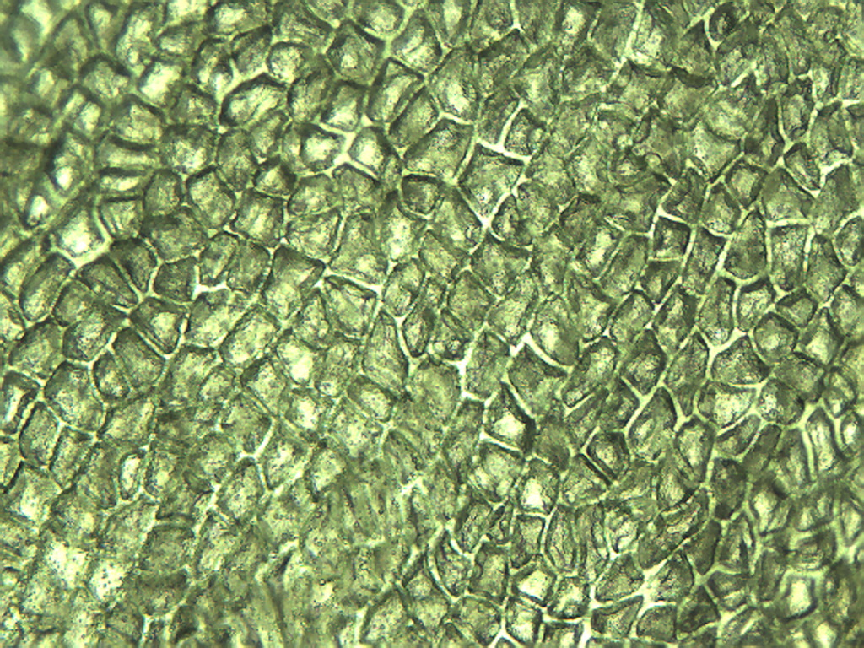
Notes:
373. Capsicum annuum L. Pepper, green. Epidermal cells, 10X.

Slide 3
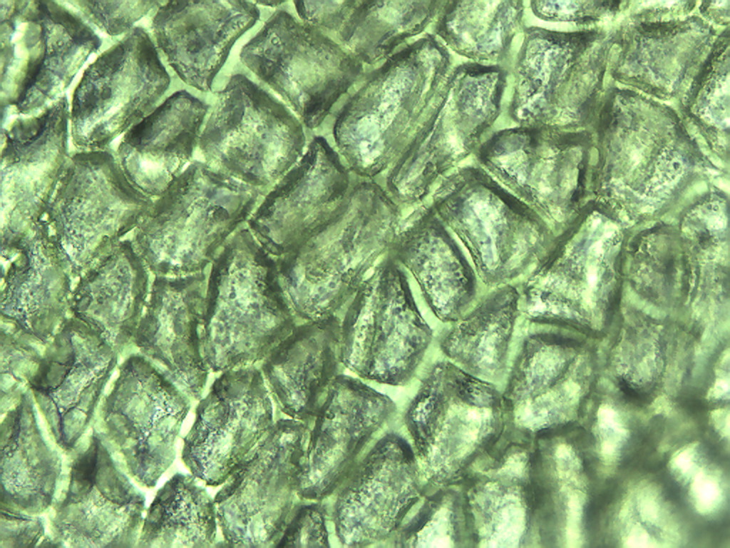
Notes:
374. Pepper, green. Epidermal cells, 25X.

Slide 4
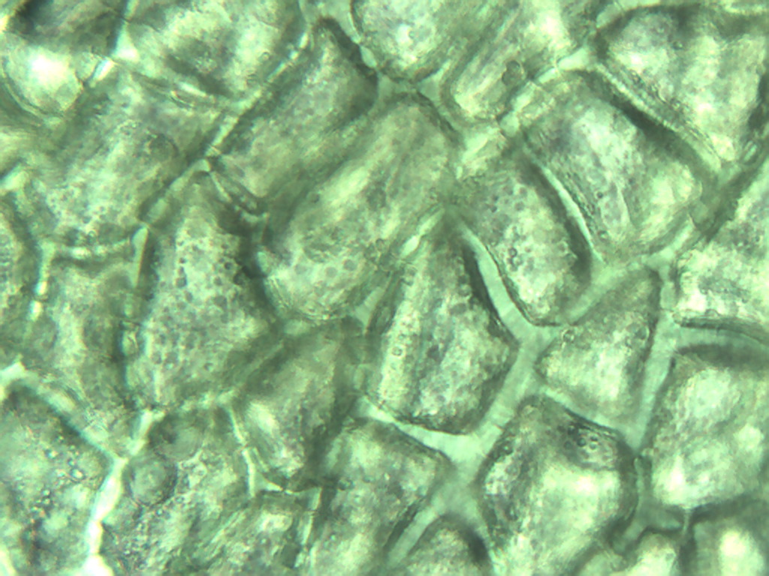
Notes:
375. Pepper, green. Epidermal cells, 40X.

Slide 5
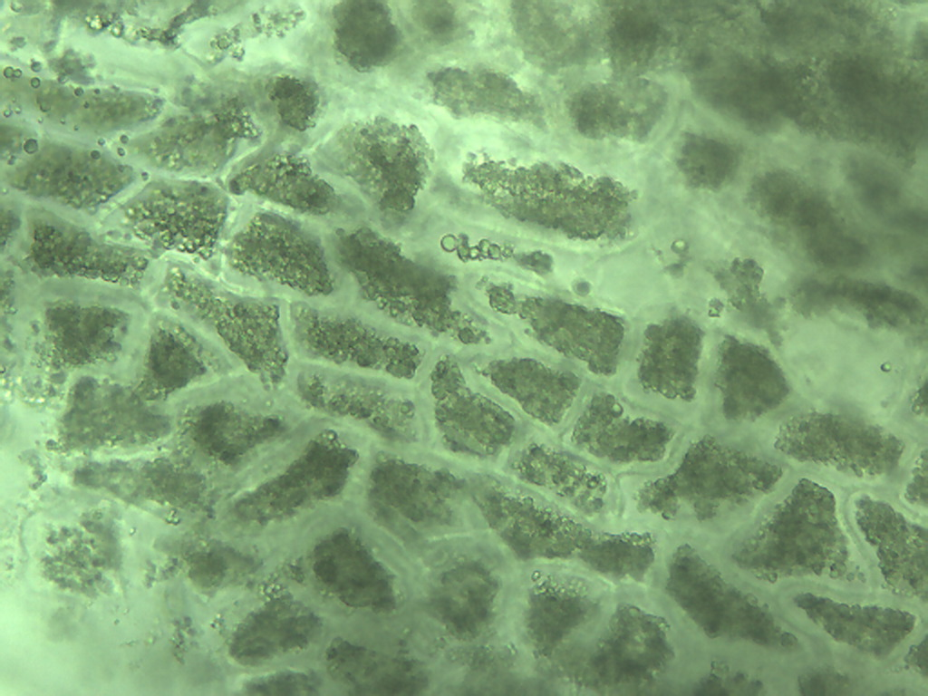
Notes:
376. Pepper, green. Cells with thick walls, 25X.

Slide 6
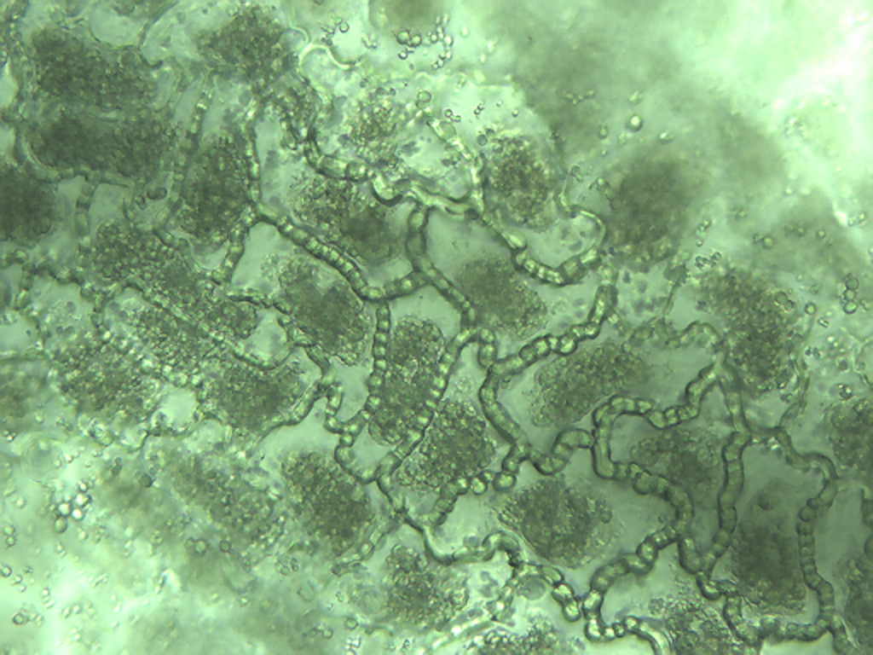
Notes:
377. Pepper, green. Puzzle-piece shaped cells with heavy walls, 25X.

Slide 7
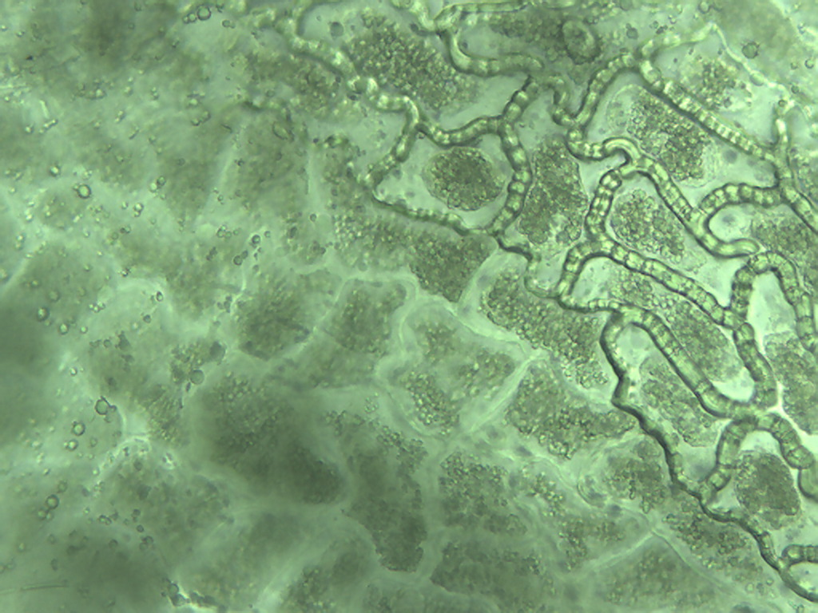
Notes:
378. Pepper, green. Comparison of thick-walled cells with numerous chloroplasts and puzzle-piece shaped cells with massive cell walls, 25X.

Slide 8
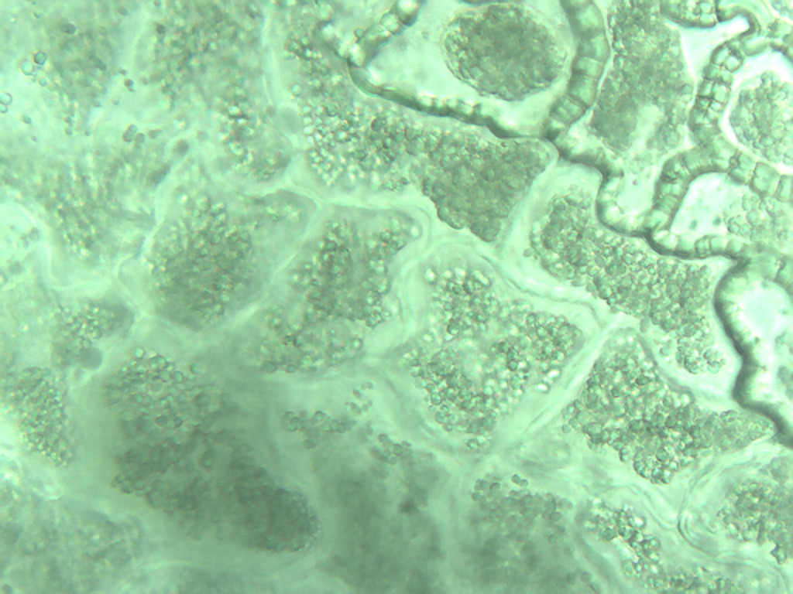
Notes:
379. Pepper, green. Cells with thick walls, 40X.

Slide 9
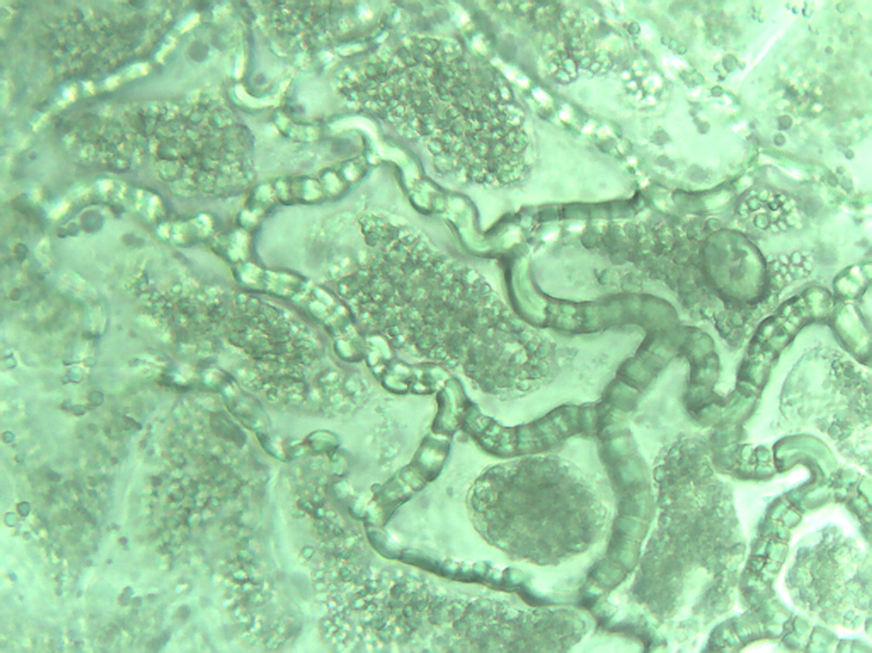
Notes:
380. Pepper, green. Puzzle-piece shaped cells with heavy walls, 40X.

Slide 10
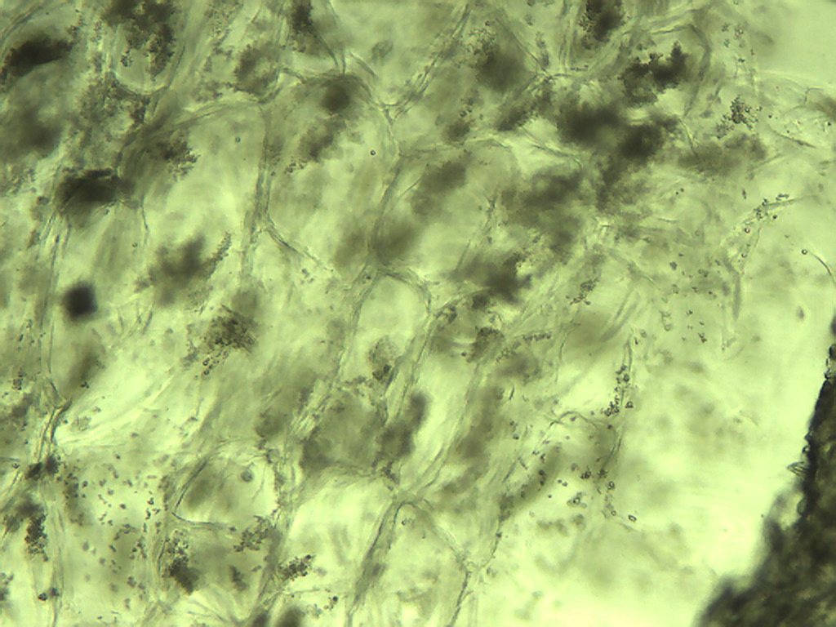
Notes:
381. Pepper, green. Smaller parenchymal cells, 10X. Compare to large parenchymal cells at 10X.

Slide 11
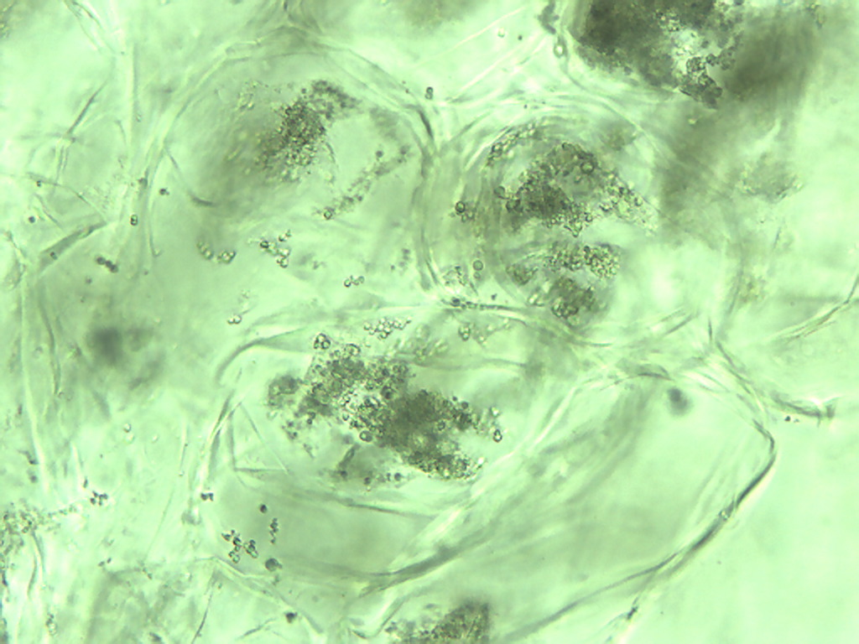
Notes:
382. Pepper, green. Smaller parenchymal cells, 25X. Compare to large parenchymal cells at 10X.

Slide 12
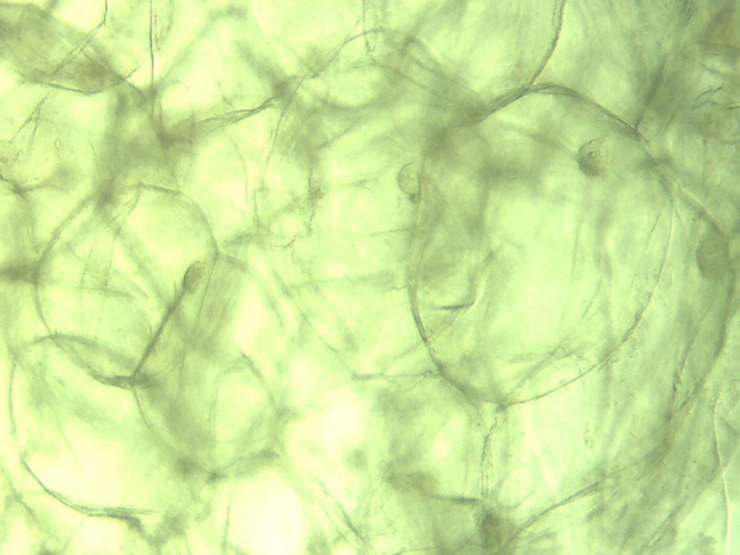
Notes:
383. Pepper, green. Large parenchymal cells, 10X.

Slide 13
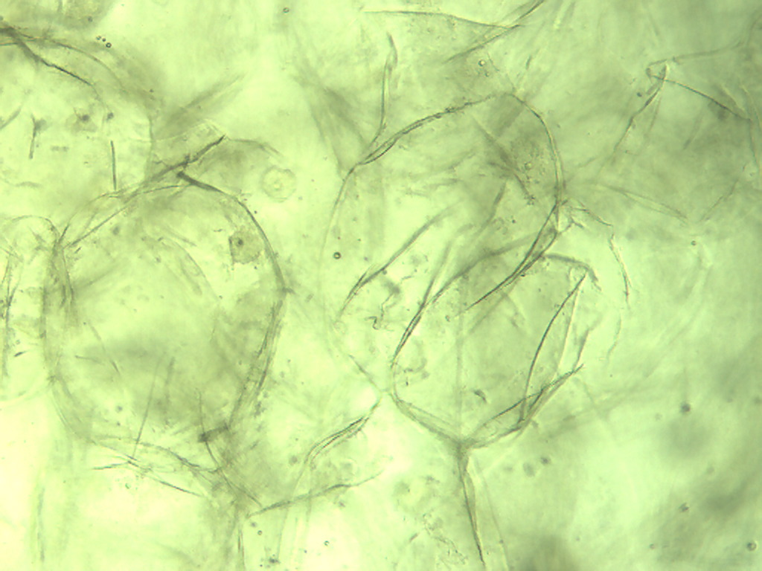
Notes:
384. Pepper, green. Large parenchymal cells, 10X.

Slide 14
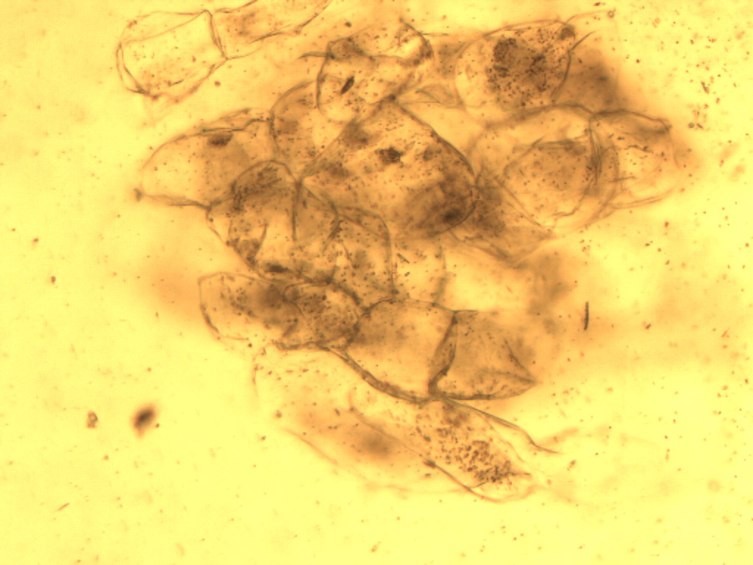
Notes:
385. Capsicum annuum L. Pimento. Parenchymal cells, stained with safranin, 10X.

Slide 15
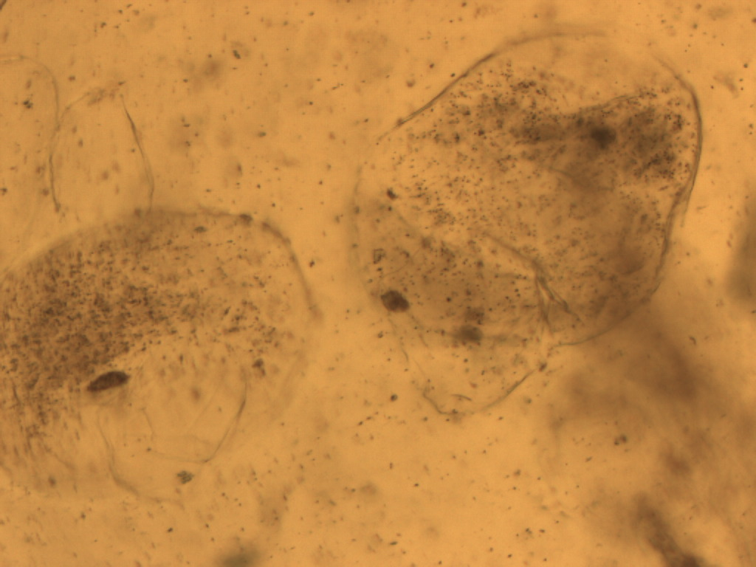
Notes:
386. Pimento. Parenchymal cell, 25X.

Slide 16
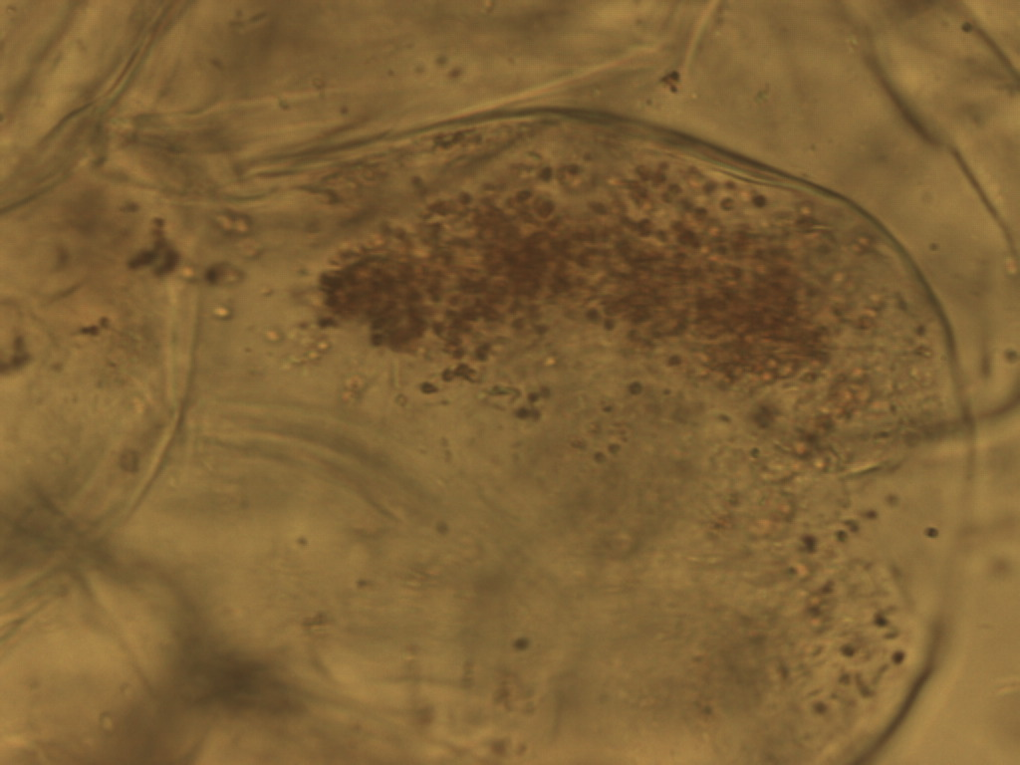
Notes:
387. Pimento. Parenchymal cell, 40X.

